Slide 1

INFORMATION SECURITY RISK ANALYSIS

Slide 2
KEY POINTS
What is Risk Management?
What is the need for Risk Management?
Approach to Risk Management
Risk Assessment

Slide 3
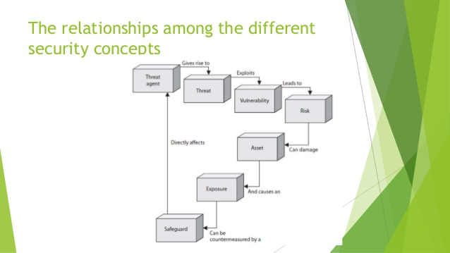
RELATIONSHIP AMONG DIFFERENT SECURITY CONCEPTS

Slide 4
TERMS AND DEFINITIONS FOR RISK ANALYSIS
Asset
Something that an organization considers important so as to be protected. For eg, a resource, process, product, computing infrastructure etc.
The loss of the asset could effect CIA or could have an overall adverse business impact.
Threat
A threat is the presence of any potential event that could cause an adverse impact on the organization.
Safeguard
A safeguard is the ‘control’ or ‘countermeasure’ put in place to reduce the risk associated with a specific threat or group of threats.
Vulnerability
The absence or weakness of a ‘safeguard’.
A minor threat has a potential to become a greater threat because of vulnerability.

Slide 5
Exposure related terms
Exposure factor(EF): Represents the percentage loss that a threat event would have on a specific asset.
EF can be a small percentage such as effect of loss of some hardware or a very large percentage such as loss of storage devices at some data center.
Single loss expectancy(SLE): A monetary figure that is assigned to a single threat event. It represents an organization’s loss from a single threat.
SLE= Asset value * EF
eg; asset value=USD 45000, EF =20% then SLE will be (45000* 0.2)
i.e. USD 900

Slide 6
Annualized rate of occurrence(ARO): Represents the estimated probability of a specific threat taking place within a one-year time frame.
The range of probability is from 0.0 to 1.0
Eg, Probability of flood is once in 1000 years, ARO value is 0.001
Annualized loss expectancy(ALE): Is a monetary value derived from
ALE= SLE * ARO

Slide 7
FORMULA FOR RISK ANALYSIS
Exposure-related concept | Formula for calculation
Exposure factor(EF) | Percentage of asset loss caused by a threat
Single loss expectancy(SLE) | Asset value * EF
Annualized rate of occurrence(ARO) | Frequency of threat occurrence per year
Annualized loss expectancy(ALE) | SLE * ARO

Slide 8
RISK MANAGEMENT AND RISK ANALYSIS
Risk analysis: Science of observation, knowledge and evaluation;
Risk management:
The ongoing process of identifying the risks and implementing plans to address them.
Skill of handling the identified risks in the best possible manner for interests of organization
Risk evaluation: Provides a baseline that can be used to focus mitigation and improvement activities.
Risk = threat * vulnerability * asset value

Slide 9
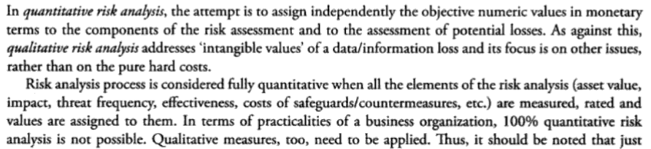
QUANTITATIVE RISK ANALYSIS

Slide 10
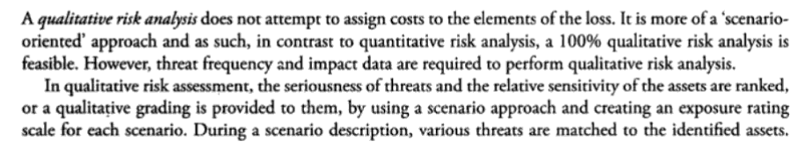
QUALITATIVE RISK ANALYSIS

Slide 11
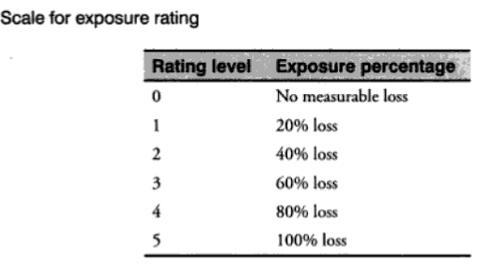
EXPOSURE RATING

Slide 12
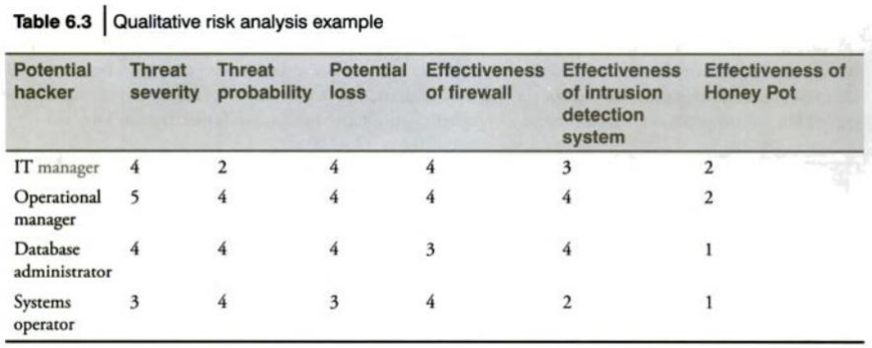
QUALITATIVE RISK ANALYSIS EXAMPLE

Slide 13
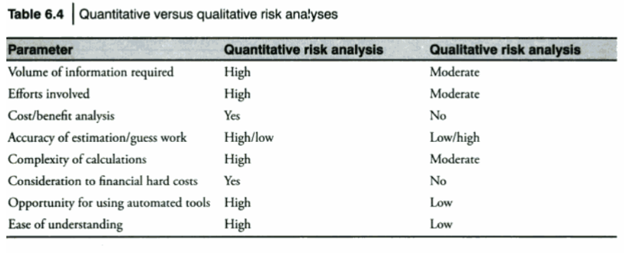
DIFFERENCE

Slide 14
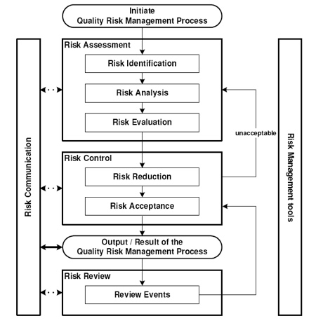
RISK MANAGEMENT PROCESS

Slide 15
STAGED METHODOLOGY FOR RISK ANALYSIS
Methodology: it is a framework for managing a task efficiently, usually including standard techniques for problem solving.
Three main stages in risk analysis:
Asset evaluation
Analysis of threats and vulnerabilities
Selection of safeguards

Slide 16
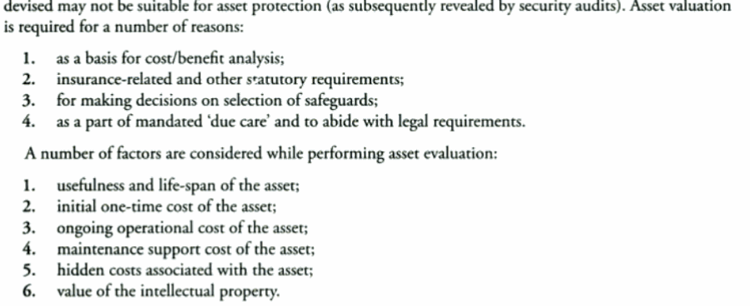
ASSET VALUATION

